Slide 1
Introduction to apcs
in c++
prerequisites: none

Slide 2
What is apcs
Implementation(實作)
C++/Python
Levels
1 -> 不要忘記去考
2 -> 具有程式撰寫能力
3 -> 具有良好程式撰寫能力
4 -> 挑戰特殊選才
5 -> 挑戰奧林匹亞
Conception(觀念)
Only c++
Levels
比較沒鑑別度
秀出來就是比較屌

Slide 3
How should I prepare apcs?
Implementation
c++ or python
Logic
Logic
Logic
magic
Concept
C++
Literacy of scary C++
Not getting angry
Math
Combinatorics
Logic
magic

Slide 4
What is c++
A programming language
Very simple if you know English and math
Let’s learn it with the try and guess way
Linguistic Olympiad style

Slide 5
How should I learn c++
Zerojudge
register your own account
Environment
download Codeblocks
Be creative
But Don’t take drugs

Slide 6
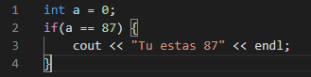
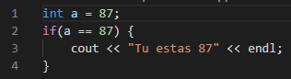
If syntax
what is the behavior?
Try it!
What is the behavior?
Guess it!

Slide 7
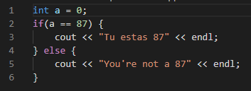
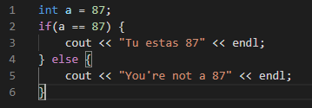
If - else syntax
what is the behavior?
Guess it!
What is the behavior?
Guess it!

Slide 8
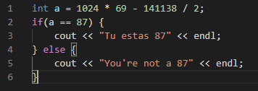
If syntax - quiz
What is the behavior?
You may use a calculator, but you may not use any programmable device

Slide 9
While syntax
What is the behavior?
What is the behavior?

Slide 10
For syntax
First statement
Second statement
Third statement

Slide 11
Function syntax

Slide 12
quiz - 1
Rewrite the following program
Using while syntax
Using for syntax
Using function syntax
Use your own imagination

Slide 13
Quiz - 2
Nested structure
Use your own imagination
Be creative
Don’t do drugs
Zerojudge
d069

Slide 14
Break
Let’s take a break before we burn our brain

Slide 15
int
Int means integer
Let talk about it’s behavior
Division
Multiplication
Modulo
Maximum
Around 2e9
5/2=?
5*2/2=?
5/2*2=?
5%2=?
1000000000*1000000000=?
Unknown behavior
Might cause program crash

Slide 16
char
It means character
Only one character
Multiple characters are string
Let’s talk about its behavior
‘a’+3=‘C’
‘B’-’A’=1
‘9’-’0’=9
Quiz 1
‘a’+(‘Z’-’Y’)=?
‘A’+9/2=?
‘P’+(‘Y’-’Z’)=?
Quiz 2
‘0’ + ’0’=?
‘0’ * ‘0’=?
‘0’ / ‘0’ = ?

Slide 17
array
A set of objects are array
One dimension -> sequence
Two dimension -> matrix
Three or more dimension -> tensor
Everything starts from 0
When a programmer counts
0,1,2,3,4,5,…
Every fucking thing starts from fucking 0
Always start from Fucking 0

Slide 18
Array - syntax

Slide 19
string
Mixture of char and array
A set of char
Like a word, sentence, paragraph or some text

Slide 20
String - quiz
Str[0]=?
Str[9]=?
Str[9]-str[0]=?
Arr[0][9]-arr[1][3]=?
String to int
Int to string

Slide 21
Quiz 1
Storaging a huge integer
Zerojudge a021
Only implement addition and subtraction
Implement multiplication and division when you are trying to torture yourself

Slide 22
Quiz 2
Simple matrix multiplication
Zerojudge d481

Slide 23
Quiz 3
Fibonacci series
Zerojudge d486
By recursion
By loop
By matrix multiplication…?

Slide 24
break
Don’t burn your brain yet, we still need it

Slide 25
input
Terminates when
Meet a space
Meet a enter(‘\n’)

Slide 26
Input - eof
Eof means end of file
Not really Practical in development

Slide 27
Input quiz
Input with n lines and without spaces
Input with unknown lines and without spaces

Slide 28
output
Cout
Setprecision
endl

Slide 29
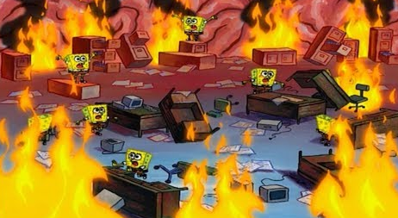
break
Describe your status with a meme

Slide 30
quiz
Zerojudge
A001
A002
A003
A005
A006
a013

Slide 31
Techniques
Go for the partial scores
You don’t have to solve the entire problem
the former problems are usually easier than the latter problems
‘usually’
‘usually’
Not always

Slide 32
extra
Recursion
Standard library(stl)
Expotationing by squaring
Modulo/fermat’s little theorem/Pascal triangle
Bitwise operations
Sorting
Time complexity estimation(prerequisites: calculus)

